Slide 1
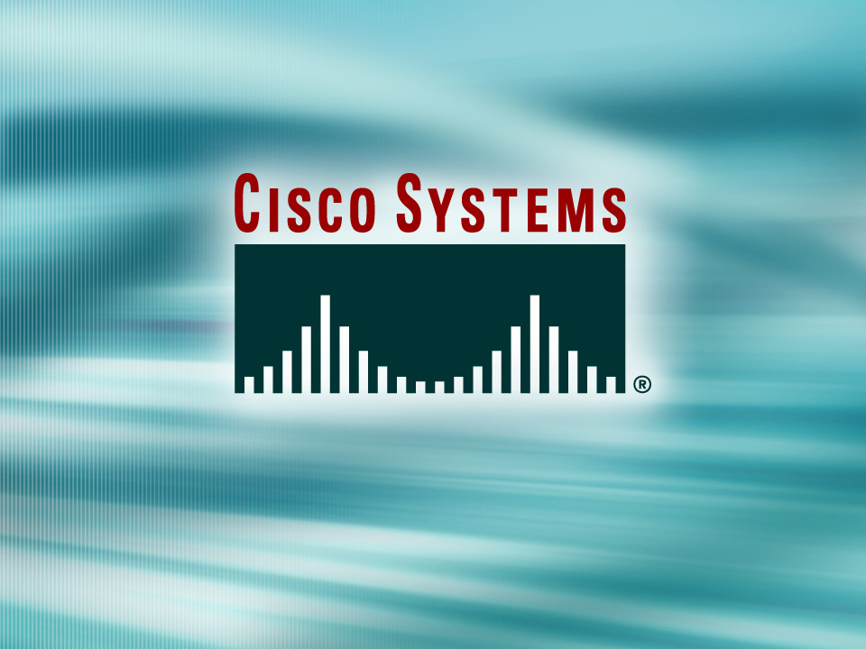
Presentation_ID
© 2001, Cisco Systems, Inc. All rights reserved.

Slide 2
Single Area OSPF
Presenter
“Insert your name here”
“Insert your email address here”

Slide 3
Agenda
Link State Protocol Review
OSPF Concepts, Structure & Operation
OSPF Implementation example

Slide 4
What is a Link State Protocol?

Slide 5
Link State Protocols
Based on Dijkstra (Shortest Path First) Algorithm
Uses LSA (Link States Advertisements)
Event Triggered
Fast Convergence in Large Networks
Notes:
Dijkstra is one of many path finding Algorithms, ie.: Best-First, A*, etc
Path finding Algorithms are used in many modern applications such as networking (Dijkstra) Gaming and Artificial Intelligence (A*), mapping and direction calculation (Dijkstra).
This algorithm creates and maintains the link-state path database as well as populates the Forwarding table (Routing Table).
LSA: Devices will only send the state of their links to other routers. Each router is then responsible for building a topological view of the network based on these LSAs.
Once the Network has converged the Routing protocol will remain ”quiet”. Any changes in the topology will trigger a new sequence of updates.
Link State protocols are designed for large networks were Distance Vector Protocols would be to slow to converge and consume a large portion of the users Bandwidth in routing updates.

Slide 6
OSPF
Concepts, , Structure & Operation

Slide 7
OSPF History
Development began in 1987 (IETF)
OSPFv2 implemented in 1991 (RFC1247)
Latest Revision – RFC 2328 (04/1998)
Notes:
OSPF was created having as a goal the creation of a more efficient and scalable routing protocol than RIP (Distance Vector)

Slide 8
OSPF vs. RIP
OSPF
RIP
Uses Metrics such as Bandwidth
Appropriate for Large Networks
Can further subdivide a network into areas
Supports VLSM
Fast convergence
Supports equal-cost multipath
Uses Hop Count
Designed for Small Networks (15 hops)
Flat hierarchy design
Non VLSM (for RIP v1)

Slide 9
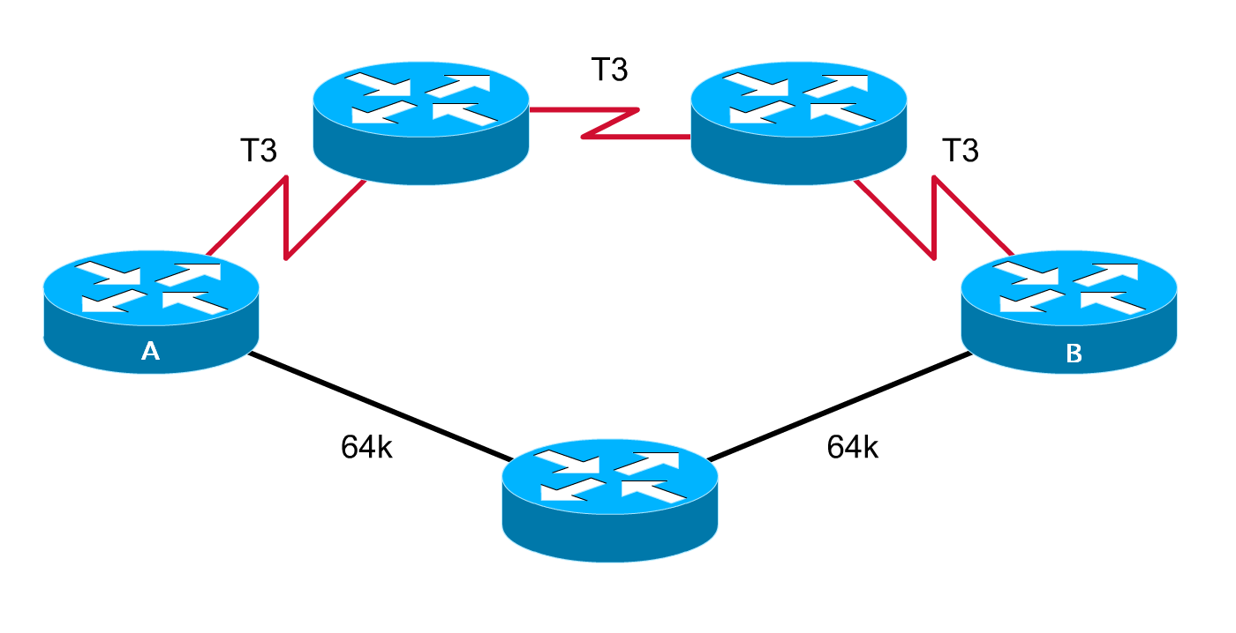
OSPF vs. RIP (cont.)
What is the Best Path from A to B?
OSPF Chosen Path
RIP Chosen Path
Notes:
OSPF chooses the best path based on bandwidth and therefore the T3 link are chosen.
RIP in the other hand uses Hop count and chooses the path that has the minimum number of hops to the destination.

Slide 10
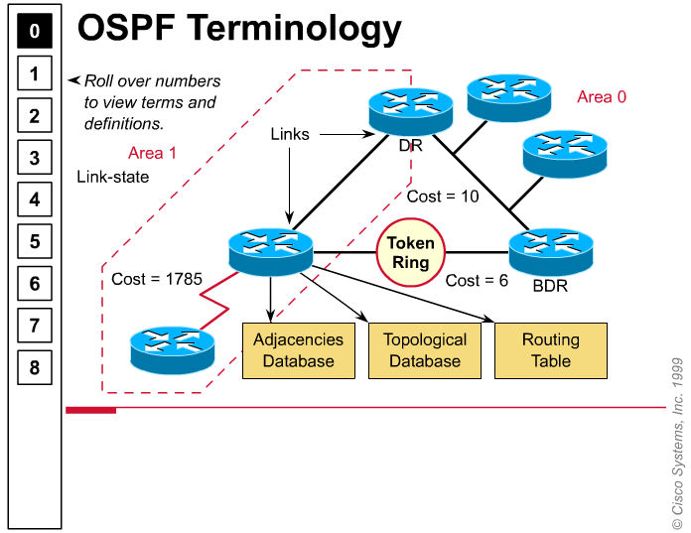
OSPF Overview
Notes:
Link --- A physical and electrical connection between two network devices.
Link-state --- The status of a link between two routers. This status includes information about a router's interface and its relationship to neighboring routers.
Cost --- The value assigned to a link. Rather than hops, link-state protocols assign a cost to a link, which is based on the speed of the network connection.
Area --- A collection of networks and routers that has the same area identification. Each router within an area has the same link-state information. A router within an area is called an internal router.
Designated Router (DR)) --- One router on an OSPF multiaccess network that is elected to represent all the routers in that network. Each OSPF network has a DR and BDR. These routers have special responsibilities that are discussed later in this chapter.
Backup Designated Router (BDR) --- A standby router that becomes the DR, if the original DR fails.
Adjacencies database --- A listing of all the neighbors to which a router has established bi-directional communication.
Link-state database (or topological database) --- A list of information about all other routers in the network. It shows the network topology. All routers within an area have identical link-state databases.
Routing table --- The routing table (also known as the forwarding database) is generated when an algorithm is run on the link-state database. Each router's routing table is unique and contains information of how and where to send packets to other routers.

Slide 11
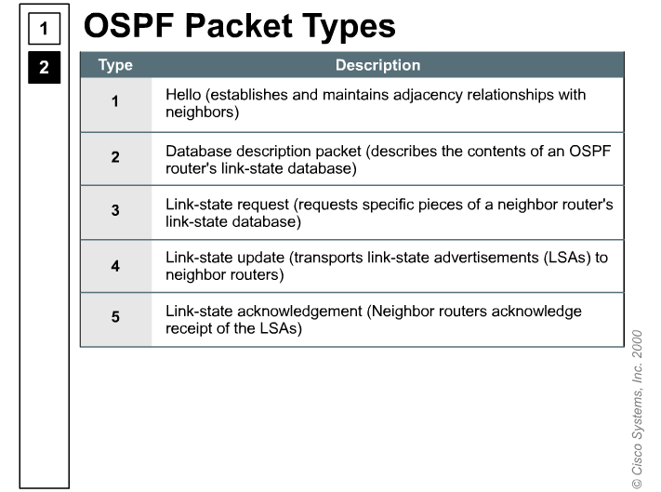
Packet types
Packet types
Hello
DDP
LSR
LSU
LSAck

Slide 12
OSPF Characteristics
Establish router adjacencies
Elect a Designated Router
Discover Routes
Select appropriate routes
Maintain routing info
Relies on IP packets for delivery of routing information (uses protocol number 89)
Notes:
OSPF
RFC 1131 – OSPF Specification
RFC 1247 – OSPF Version 2
RFC 2329 – OSPF Standardization Report

Slide 13
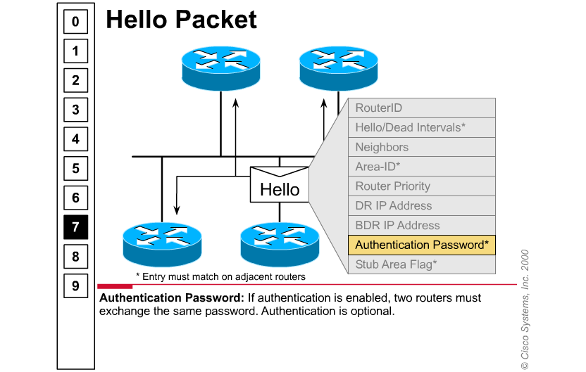
Hello Packets
Notes:
Router ID --- Used to identify a router to OSPF. The highest IP address on an active physical or loopback interface is used as the Router ID. This identification is important in establishing neighbor relationships and coordinating messages between OSPF routers on the network. Also, the Router ID is used to break ties during the DR and BDR election processes if the priority values are equal. (DR and BDR are discussed later.)
Hello interval --- Specifies the frequency in seconds that a router sends out Hello messages (the default is 10 seconds on multiaccess networks), as shown in the Slide. The Hello interval must be the same on neighboring routers.
Dead interval --- The dead interval is the time in seconds that a router waits to hear from a neighboring router before declaring the neighbor down (four times the Hello interval by default). The Dead interval must be the same on neighboring routers.
This Hello process also provides quicker detection of failed routers because Hellos are exchanged every 10 seconds. Routers expect to hear from their neighbors every 10 seconds. If a router is silent for 40 seconds, its neighbors believe it is down. Note: This is true if you assume default configuration values.
Neighbors --- The neighbors to which adjacencies have been created. (At the initial startup point, this field is empty because the first router has not received Hello messages from other routers.)
Area-ID --- The common identification number for an area. To communicate, two routers must share a common network segment, have interfaces configured to belong to the same area on that segment, and share the same subnet address and mask. Routers from the same area will each have the same link-state database information.
Router Priority --- A value that indicates the priority of this router when selecting a Designated Router (DR) and Backup Designated Router (BDR). The default priority is 1 and can be configured to a higher number to ensure a specified router becomes the DR.
DR and BDR --- The IP addresses of the DR and BDR for the specific network, if known.
Authentication password --- If authentication is enabled, two routers must exchange the same password. Authentication is optional.
Stub area flag --- Indicates the presence of a stub area. A stub area is a special area that has only one router that connects to another area. Two routers must agree on the stub area flag in the Hello packets.

Slide 14
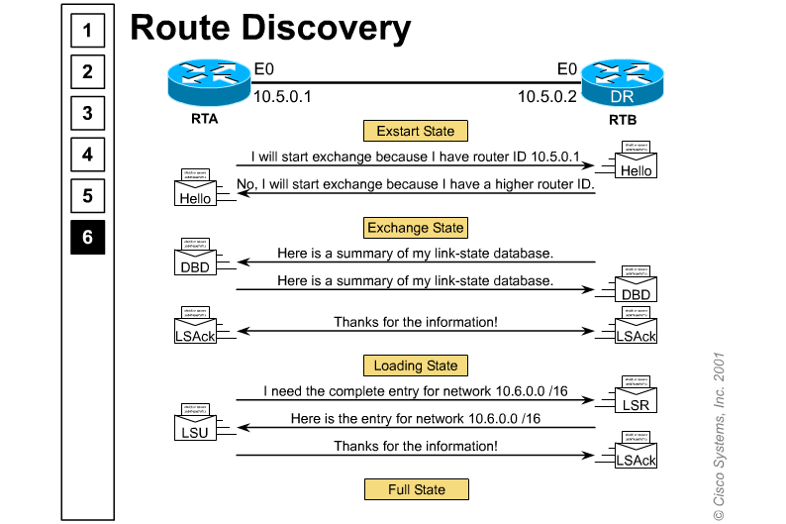
Keeping up with the several OSPF states
Notes:
Detailed exchange for DR and BDR election:
Router A is enabled on the LAN, but OSPF is in the down state because it has not exchanged information with any other router. Router A sends a Hello packet containing information about itself to the network. This information includes Router A's Router ID.
All OSPF routers with the IP multicast address enabled receive the Hello packet from Router A and store the information about Router A locally. This is the Init state.
All routers that received the Hello packet send a unicast reply Hello packet to Router A with their corresponding information. A unicast packet is a packet addressed to one specific device on the network. The information that the responding routers send includes details about all neighboring routers, including Router A.
When Router A receives these reply packets, it adds all the routers that had its (Router A's) Router ID in their packet to its own database. This step is referred to as the two-way state. At this point, all routers that have learned about each other establish bi-directional communication.
Next, neighbor routers select the DR and BDR. The DR and BDR election process is described in the "Step 2" next section. This process must occur before routers can begin exchanging the complete link-state information (information about the network topology and routing devices). Link-state exchanges are discussed in the "Step 3" section to follow.
Neighboring routers then determine the master/slave relationship between themselves (e.g. who will initiate sending the link-state advertisements?), exchange LSAs that describe each router's link state database, and establish full adjacency.
Periodically (10 seconds by default), the routers within a network exchange Hello packets to ensure communication is still working. These Hello "keepalive" updates include the DR router ID and the list of routers whose Hello packets have been received by the router sending the Hello.
Detailed sequence for Route Discovery:
In the Exstart state, the DR and BDR establish adjacencies with each router in the network. During this process, a master-slave relationship is created between each router and its DR/BDR. The router that has the higher router ID acts as the master.
Note that link-state information is exchanged and synchronized only between the DR/BDR and the routers to which they have established adjacencies. Having the DR represent the network in this capacity reduces the amount of routing update traffic.
The master and slave routers exchange one or more database description packets (DDPs). This is referred to as the Exchange state.
A DDP includes an LSA (link-state advertisement) that describes the router's link-state database. Each database description LSA includes a variety of information such as link-state type, the address of the advertising router, the cost of the link, and the sequence number. The sequence number is a router's way of determining the order in which the link-state information was received. The initial sequence number used by the adjacent routers to start keeping track of the LSA sequence is defined by the master.
When the slave router receives the DDP, it does the following:
Acknowledges the receipt of the DDP by echoing the link-state entry sequence numbers in a link-state acknowledgment (LSAck) packet, as shown in the figure..
Compares the information it received with the information it has. Remember, the initial entries put into the link-state database are from the adjacencies database. If the DDP has a more up-to-date link-state entry, then the slave router sends a link-state request (LSR) to the master router.
The master router responds with the complete information about the requested entry in a link-state update (LSU) packet. Again, the slave router sends an LSAck when the LSU is received. The process of sending LSRs is referred to as the Loading state.
All routers add the new link-state entries into their link-state database.
After all LSRs have been updated for a given router, adjacent routers are considered synchronized in a Full state. The routers must be in the Full state before they can route traffic. At this point, the routers should all have identical link-state databases.

Slide 15
OSPF Cost = Metric
Cost is applied on all router link paths
16 bits number (1 – 65,535)
Lower metric = more desirable
Route decision is made on total cost of the path.

Slide 16
OSPF Metric
Metric is derived from Bandwidth
Bandwidth and Cost can be configured by the user, i.e. :
  Router(config-if)# bandwidth 128
  Router(config-if)# ip ospf cost 2305
100,000,000
Formula COST =
Bandwidth
OSPF Cost for T1 = 100,000,000 / 1,544,000 = 64

Slide 17
OSPF Areas
OSPF uses a 2 level hierarchical model
Areas are defined with a 32 bits number
  Can be either in IP format or single decimal value:
  Area 0 or Area 0.0.0.0
All areas must be connected to Area 0 (Backbone)

Slide 18
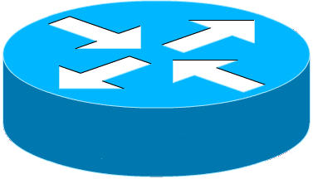
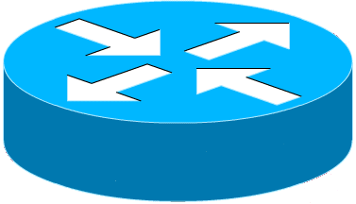
OSPF Areas example
Area 1
ABR
Area 0 (Backbone)
ABR
Area 4
Area 2
Area 3
Notes:
OSPF has to have at least one Area (Area 0 ). This area is the bacbone were all the other areas must be connected to.
ABR: Area border Routers are routers that have interfaces in more than one area, generally between Area 0 and other areas.

Slide 19
OSPF Packets
There are 5 types of OSPF routing protocol packets
  Function Name
  Hello Hello
  Database Description DBD
  Link-State Request LSR
  Link-State Update LSU
  Link-State Acknowledgement LSAck

Slide 20
OSPF in Multi-Access media
Giga/Fast/Ethernet, FDDI, Token Ring
DR
BDR
BDR
DR
Notes:
DR : Designated Routers >>
Reduce OSPF traffic on Multiaccess Links
Store and Distribute neighbors LSDBs
BDR exist as a backup for redundancy.
DR election:
OSPF Priority is used in the selection : 1 – 255, default = 1, 0 for noncandidate
If priorities are the same, higher Loopback IP address.
In case of no existing Loopbacks highest IP address of interfaces are used.
OSPF Order of events:
Establish router adjacencies
Elect a Designated Router
Discover Routes
Select appropriate routes
Maintain routing info
Relies on IP packets for delivery of routing information (uses protocol number 89)

Slide 21
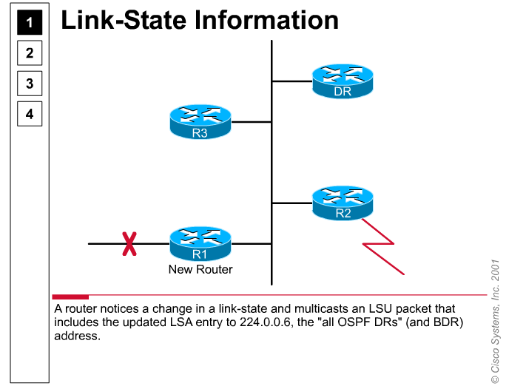
OSPF Single Area
R1 to DR :
224.0.0.6
DR to all Routers:
224.0.0.5

Slide 22
OSPF Basic Commands
Router(config)# int loopback 0
Router(config-if)# ip address 1.1.1.1 255.255.255.255
Router(config-if)# router ospf 100
Router(config-router)# network 10.1.2.0 0.0.0.255 area 0
Used for
Router ID
Wildcard Mask
(Inverse Mask)
Area ID
Note: the backbone has to be 0

Slide 23
OSPF Basic Commands
Router(config-router)# default-information originate
Router(config)# int s0/0
Router(config-if)# ip ospf priority 3
Router(config-if)# bandwidth 64
Redistribution of the Default Route into the OSPF net.
Sets the priority for DR/BDR elections
Sets Bandwidth used as metric

Slide 24

Don’t forget to complete the evaluation Form
Thank YOU!

Slide 25
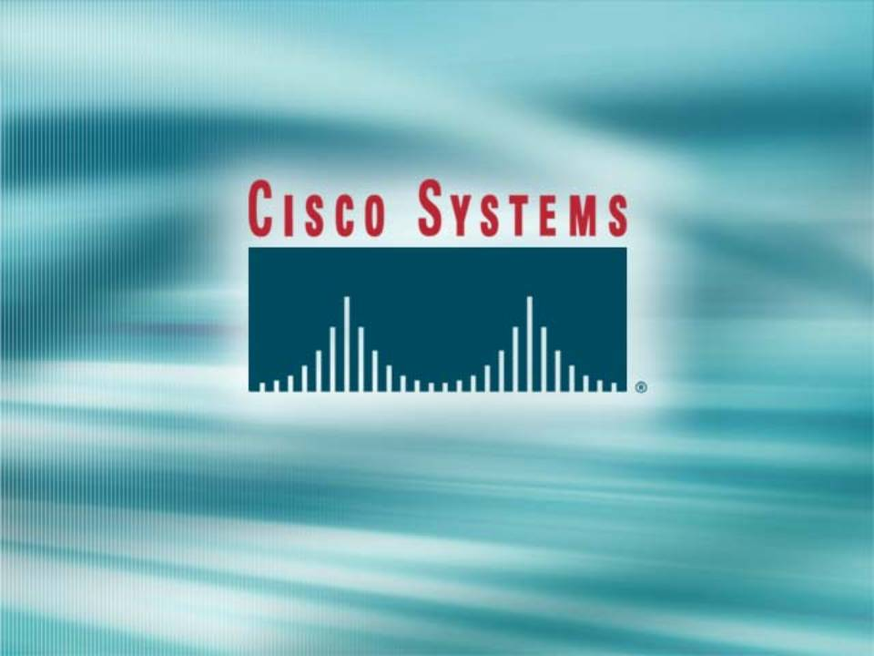
Created by
J. Straube

Slide 26
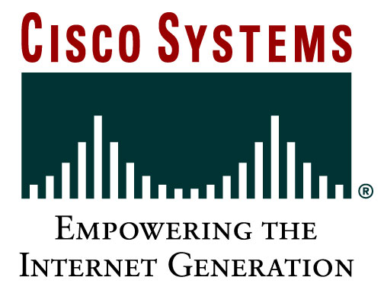
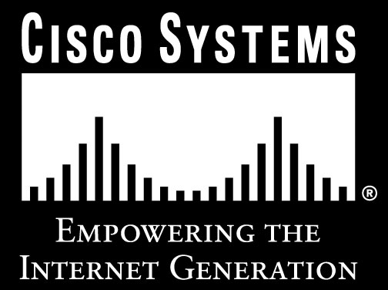
Presentation_ID
© 2001, Cisco Systems, Inc. All rights reserved.

